Slide 1
Ggplot2 and interactive graphics with R
Christophe Ladroue
SECTION 02
VIDEO 03
Bar Charts
www.PacktPub.com

Slide 2
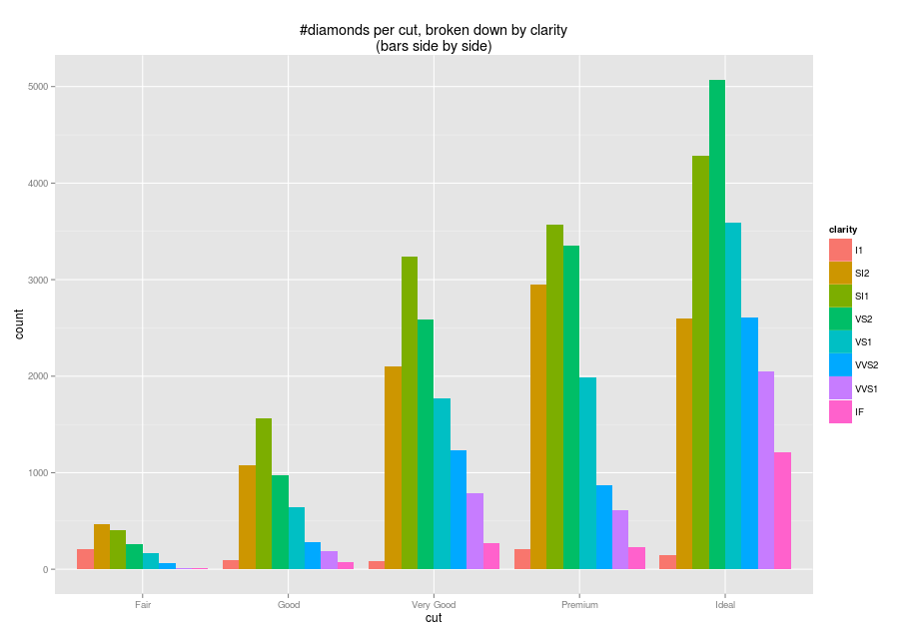
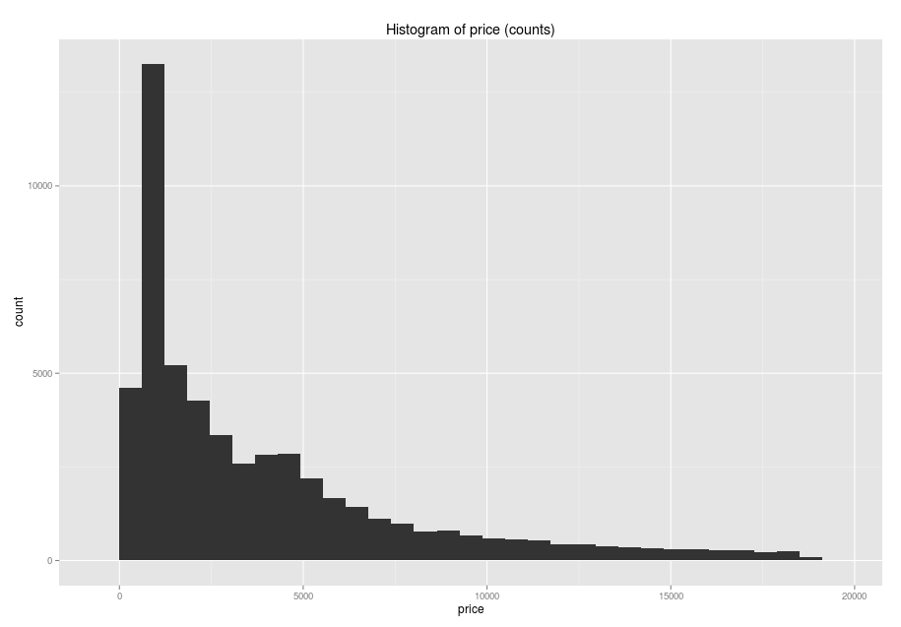
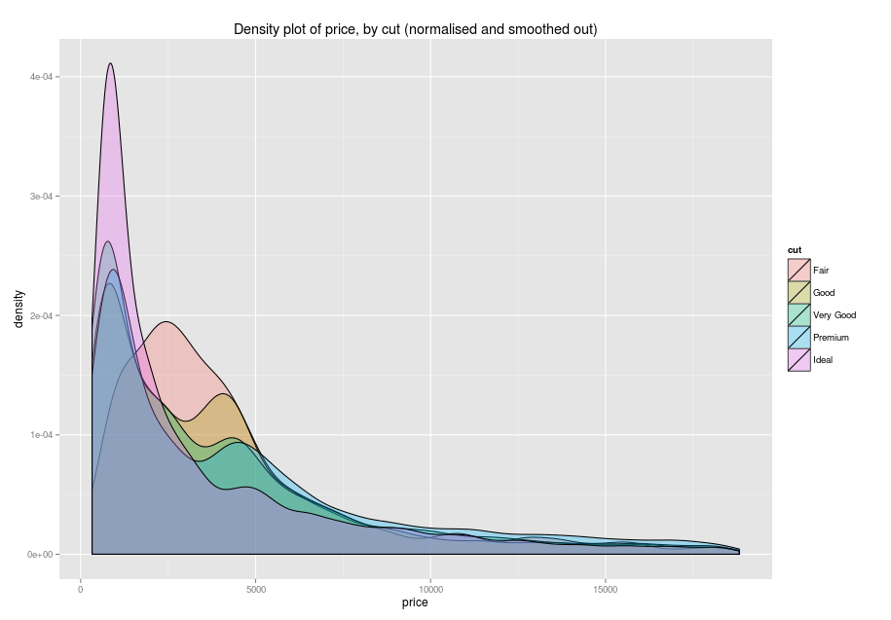
In this video we took a look at
how to use geom_bar() to create bar charts from one or two dimensions.
how to use the ‘position’ parameter to control their location on the graph.
Next: Histograms and density plots

